Slide 1
Public Health Initiative
Hosted By: Ffutche Foundation

Slide 2

Objectives
The Mission
The Achievements
The ongoing projects
Support

Slide 3
The Problem
With 45 million Americans uninsured, and CNN reporting that 45,000 Americans are dying per year because they don't have access to health care
The Solution
Providing the general public accessibility to insight on their current conditions as well as whether or not they should seek medical attention.

Slide 4
The Mission
To improve the health of the population through health campaigns, which include health data collection, free generic tests, free generic drugs, free consultations, etc.
To foster affordable education through scholarship opportunities and workforce training programs
To drive local development through awareness campaigns, fundraising for specific projects, etc.

Slide 5

The Achievements
The healthcare initiative consistently strives to create an impact in our society. On the right, we have received the following awards and achievements since 2012.
This campaign has encouraged more than 10 million people to follow up with a health care provider regarding their current health.
Provide volunteers and medical students with hands-on experience through workforce training programs

Slide 6
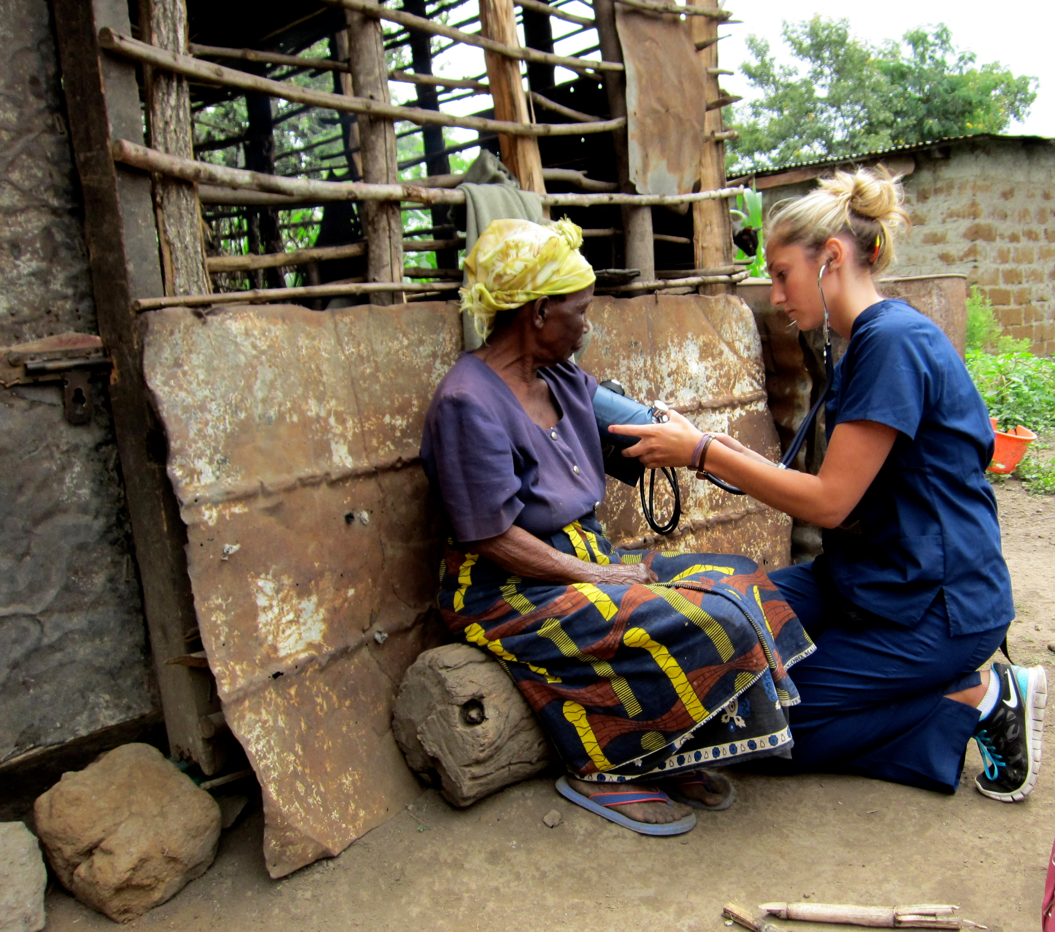
Ongoing Projects
Campaigns have expanded throughout the United States
Every 6 months we hold organized events at medical schools as well as public schools
We allow experienced medical students to travel to other countries to help those in need

Slide 7
Estimates or costs of one or two charity events
To provide insight on the cost of a Fundraiser/Charity event
-Fundraising Activity/Method National Cost to Raise a Dollar 1. Capital Campaign/Major Gifts $ .05 to $ .10 per dollar raised. 2. Corporations and Foundations (Grant Writing) $ .20 per dollar raised. 3. Direct Mail Renewal $ .20 per dollar raised. 4. Planned Giving $ .25 per dollar raise¾and a lot of patience! 5. Benefit/Special Events $ .50 of gross proceeds. 6. Direct Mail Acquisition $ 1.00 to $ 1.25 per dollar raised. 7. National Average $ .20

Slide 8
Support
As time progresses, medical supplies are becoming increasingly expensive
Our funds to help students pay for medical school are slowly depleting
The campaign is in need of further sponsorship and funds to help continue and grow
We must keep in mind that our constant efforts to inform and provide for the general public have already saved millions of lives
We only ask that you help us support our vision towards a healthy and stronger nation
We can’t help everyone, but everyone can help someone. – Ronald Reagan

